Slide 1
Hotel Bookings – Technical Presentation
Date: 10/1/2020
Presenter: Thomas Simon

Slide 2
Cancellations are a hindrance to revenue.
!
We need to look for cancellation trends across different months, market segments, etc. since revenue is directly impacted and look for ways to mitigate any potential losses.
Problem 1
Cancellations are leading to a loss in potential revenue.

Slide 3
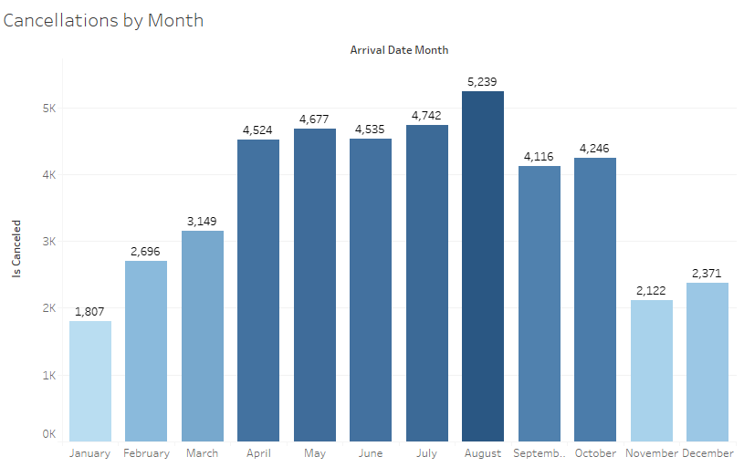
With Zero Correlation between all of the variables, Cancellations seem to be seasonal.
Key Insights
Cancellations are happening 2-3k more times throughout the summer months. With no correlation between the variables, looking at the data by market segment and distribution will have the most significant information for us to learn from.

Slide 4
Descriptive statistics was used to understand the current standing of each individual variable, while Inferential statistics was used to understand how these variables correlate with cancellations and each other.​
How can we decrease annual hotel cancellations by up to 5% through examining the average daily rate, lead time, type of hotel, total number of individuals attending, and market segment, by year 2018?
Descriptive Statistics
Inferential Statistics

Slide 5
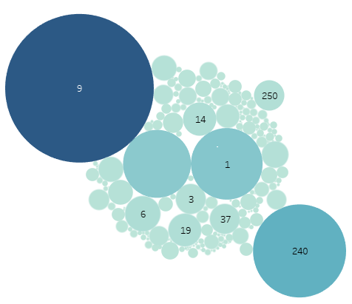
Travel Agent #9 is losing a little over $1.6M, almost 3 times greater than the 2nd worst performing agent for cancellations.
Key Insights
Online Travel Agents result in the most cancellations, with about 75% of the total compared to other market segments. With these agents garnering 3 times more cancellations than other avenues, we should primarily focus here until we can reasonably mitigate lost revenue.
Agents #9, #240, and #1 are the largest contributors to lost revenue as a direct result of cancellations. We should consider looking further into why these distributors have a much higher cancellation rate relative to the others.

Slide 6
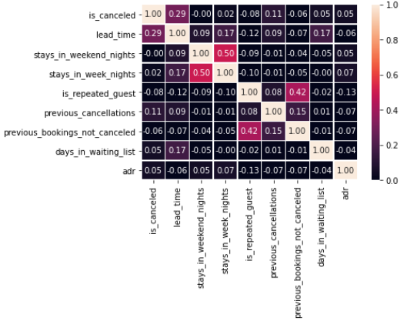
There is zero correlation between cancellations and other variables.
Key Insights
When examining the correlations between each variable, I noticed something very interesting: none of these data points have any significant correlation with each other. This confirmed my belief that there’s likely more of a problem with how the sale of hotel rooms are distributed via agents rather than any of these other listed variables.

